Slide 1
The special History of Rochelle School of the Arts
Nov. 21, 2019

Slide 2
legacy
Something received from an
ancestor (a family member who lived before you)
or from a predecessor (someone who came before you) from the past, or
Ideas or experiences handed down from those who came before us

Slide 3
Special guests
Mr. Terry Coney, Rochelle and Washington Park Alumni Association Vice President
Mrs. Rosa Hughes, a 1969 graduate of Rochelle High School
Reverend Edgar T. Pickett, a Rochelle High School and Lakeland High School graduate.

Slide 4
A timeline of Rochelle

Slide 5
Professor William A. Rochelle February 1, 1867 – August 28, 1955
William Rochelle was born on a boat that was traveling on the St. John’s River while his family was on the way to Lakeland, Florida. He earned credits from what is now Florida A & M University in Tallahassee and also completed advanced coursework at Hampton Institute in Hampton, Virginia.
Mr. Rochelle was a member of the St. James Lodge of Masons, Independent Pallbearers, the Teachers’ Association, and the Negro Chamber of Commerce. Mr. Rochelle founded the Negro Boy Scouts in Lakeland and was active in the Red Cross, Community Chest, and other community causes. He was a founding member of the Foster Memorial Methodist Church and was one the church’s trustees.

Slide 6
He was active in racial and inter-racial movements in Lakeland and he was awarded a citation for his work in educational community activities by the Negro Chamber of Commerce.
Mr. Rochelle was 89 when he died at Morrell Memorial Hospital (later Lakeland Memorial Hospital and now Lakeland Regional Medical Center). He was laid to rest at the Tiger Flowers Cemetery in Lakeland next to his wife, Lucy Rochelle (April 1, 1868-August 6, 1955). He also had a brother, Elder Stamper and a sister, Dr. Emma Wheeler.
He spent 55 years in the field of education and 22 of those were as principal of Washington Park High School. The school’s name was changed in 1949 to Rochelle High School in honor of Mr. Rochelle and his contributions to education.

Slide 7
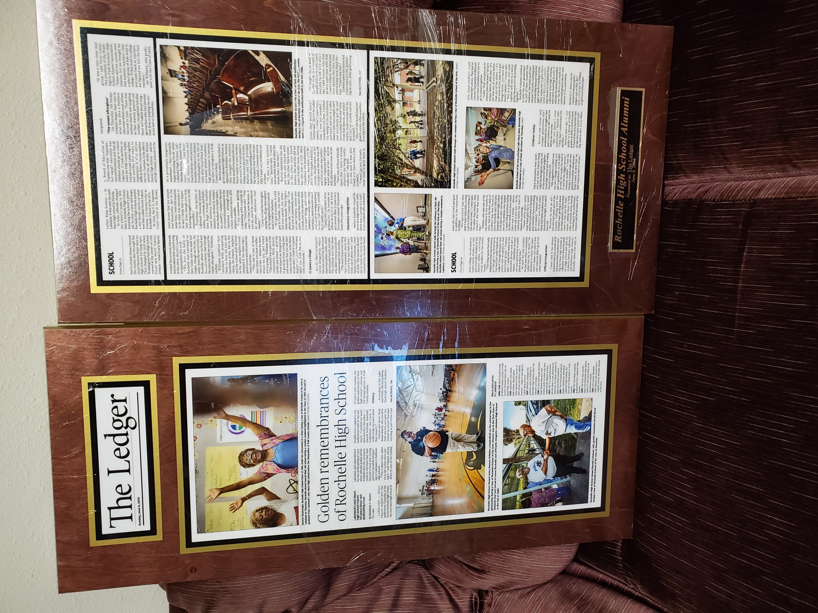
Special presentations

